Slide 1


Bus Early Departure Prevention Efficacy Study
01/07/2024

Slide 2
Objective
Increase on-time bus departures by reducing early departures.
“Text” drivers’ MODs when they run ahead of their schedule.
Discipline drivers who consistently run ahead of their schedule.
In this presentation, we will see whether and how effective each of these prevention strategies are.

Slide 3
Discipline Interventions

Slide 4
Main Results
Employment actions are an effective way to encourage on-time departures.
On average, employment actions reduce an operators’ mean daily early departure rate by 9.7%.
On average, employment actions increase an operators’ mean daily adherence seconds by 54 seconds.
On average, after receiving discipline, bus operators take about 150 days before their daily early departure rate exceeds 15%, and about 300 days before it exceeds 20%.

Slide 5
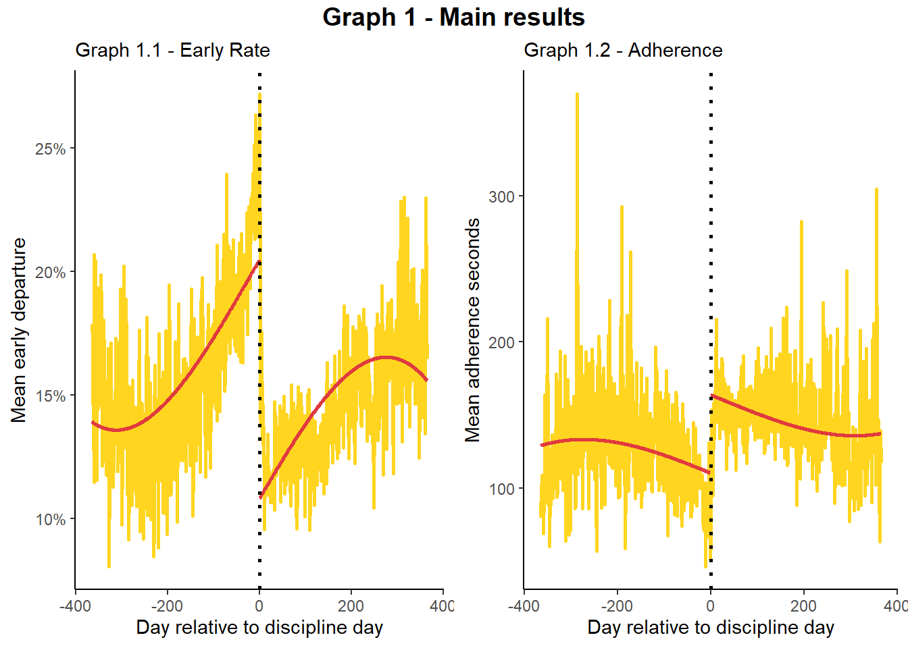
Gap shows impact of discipline on outcome ~ 10% drop
Effect lasts about 150 days
Average over days relative to the day the operator received the discipline.

Slide 6
Individual Drivers Responses to Discipline

Slide 7
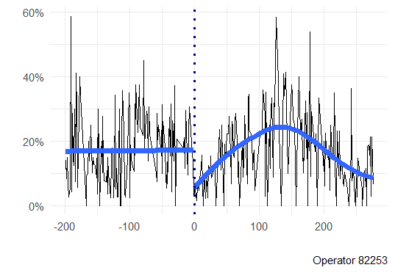
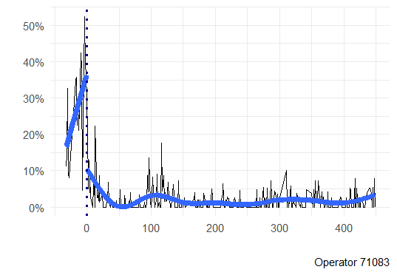
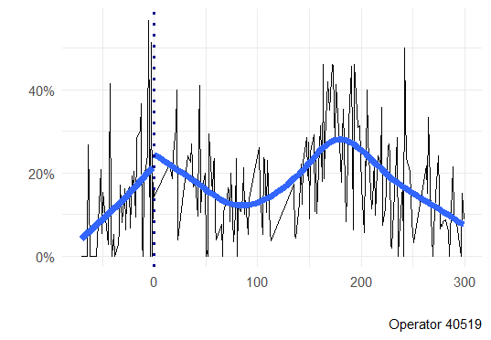
About half of operators responded to discipline (165 out of 305)
Daily early departure rate
Strong reaction
Weak reaction
Reversion
Days in relation to discipline

Slide 8
Text Interventions

Slide 9
Main Results
Messages to drivers’ onboard Mobil Data Terminal are an effective way to encourage on-time departures.
On average, drivers who receive a text message immediately increase adherence by 34 seconds, bringing them closer to. This adjustment does not return them to their schedule immediately.
On average, drivers who receive a text message adjust 8 seconds closer to on-time with each subsequent stop after receiving their text message.
After receiving a text, drivers depart remaining time-point stops 36 seconds early on average.
On average, drivers who received a text message reduced their early departure rate by 13% after receiving the text.
Drivers depart their first time-point stop after receiving the text an average early 42% of the time.
On average, drivers who received a text message reduced their early departure rate by 2% with each subsequent stop.
After receiving a text, drivers depart 32% of remaining time-point stops early.

Slide 10
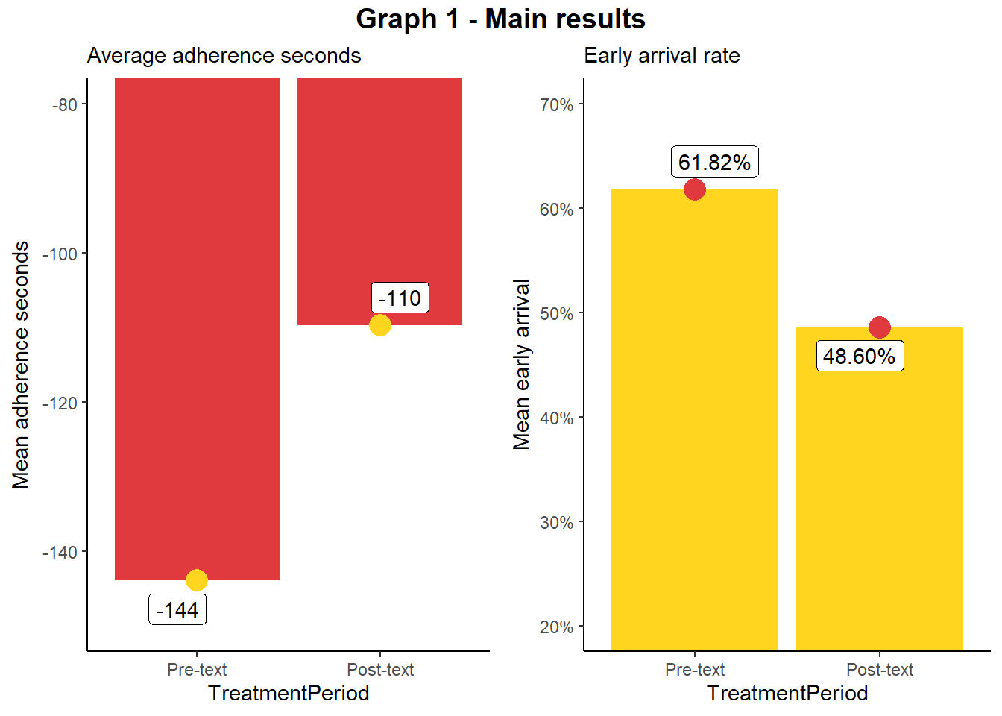
13%
34 Seconds

Slide 11
Text Effects for Individual Drivers

Slide 12
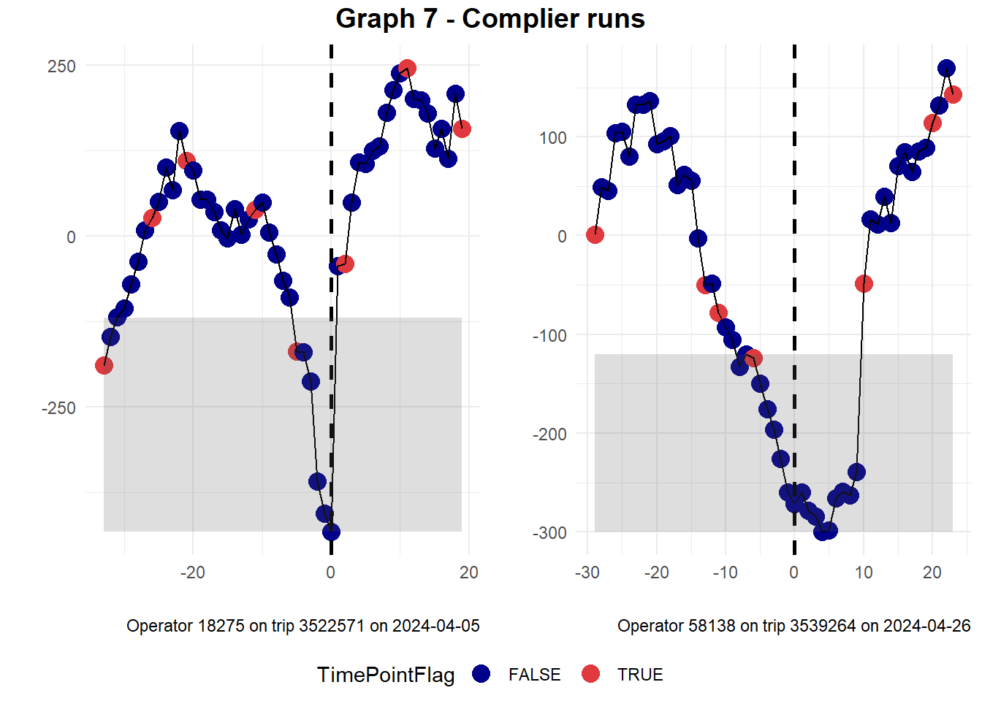
Adherence seconds
Time-point stop
Stop relative to text message stop

Slide 13
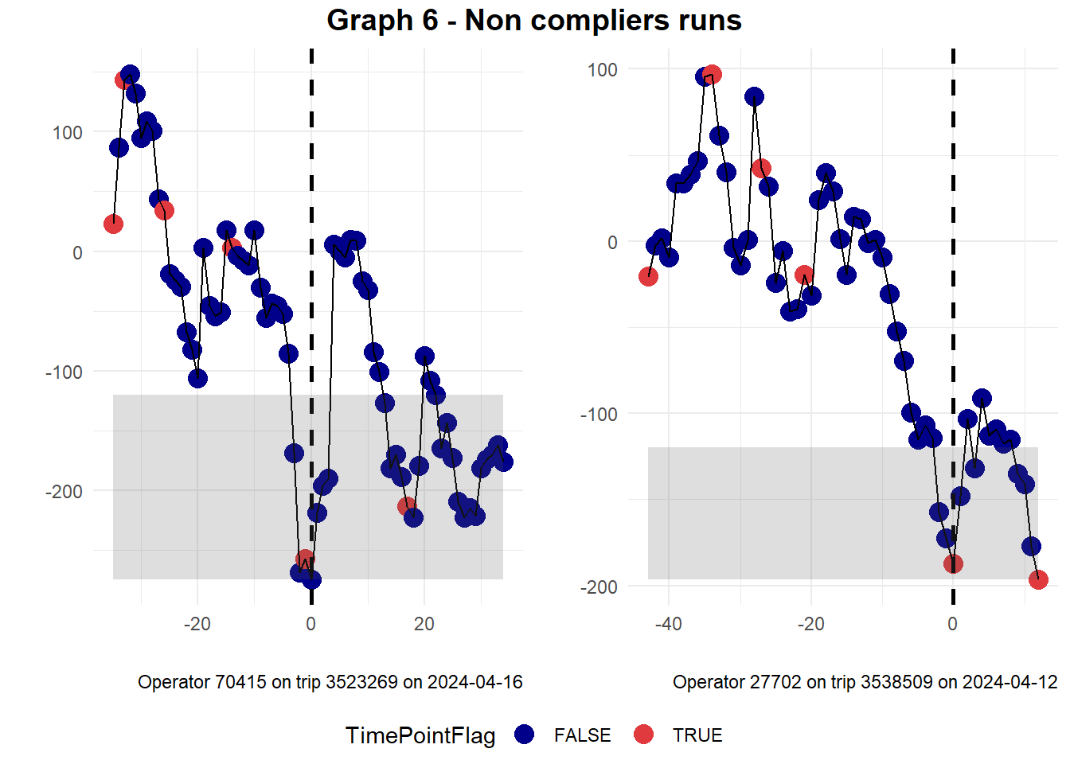
88% of operators responded to the text message (360 out of 409)

